Slide 1







Trends in Technology and Analysis
Laeticia Osemeke
May 8, 2022

Slide 2



OUTLINE
Executive Summary
Introduction
Methodology
Results
Visualization – Charts
Dashboard
Discussion
Findings & Implications
Conclusion
Appendix

Slide 3

EXECUTIVE SUMMARY
Trends in programming languages and databases
Demographics survey
Technological gap in countries
Gender gap in jobs

Slide 4

INTRODUCTION
This presentation analyzes the trends in software development
It sets to answer the following questions:
What are the top programming languages in demand?
What are the top database skills in demand?
What are the popular IDEs?
What skills and languages will be in future demand?
Audience: Human Resource and IT Head

Slide 5

METHODOLOGY
Data Collection Sources
Stack Overflow Developer 2019 Survey
GitHub Job Postings
Programming Languages Annual Salary
Data Exploration
Data Cleaning
Data Visualization
Presentation

Slide 6
RESULTS:

Slide 7
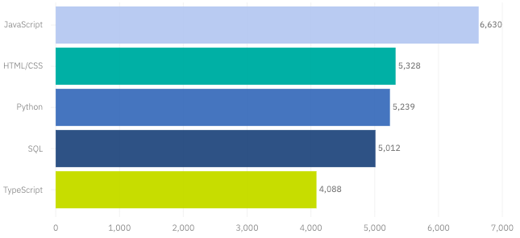
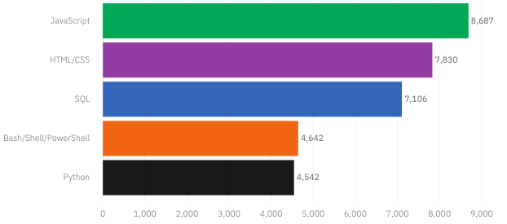
PROGRAMMING LANGUAGE TRENDS
Current Year
Next Year

Slide 8
PROGRAMMING LANGUAGE TRENDS - FINDINGS & IMPLICATIONS
Findings
JavaScript, HTML/CSS, SQL are top 3 this year
Python and Typescript becoming popular next year
PowerShell edged out in next year
Implications
Web development are still in high demand
Big Data technology in companies still requires SQL
With AI and ML in rising demand, Python is best choice

Slide 9
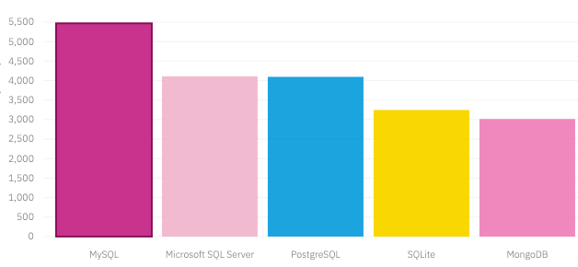
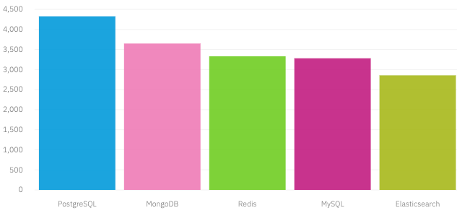
DATABASE TRENDS
Current Year
Next Year

Slide 10
DATABASE TRENDS - FINDINGS & IMPLICATIONS
Findings
MySQL is the most popular
Behind is Microsoft SQL
MongoDB and Redis are upcoming favorites
Elasticsearch can be thought of as the new kid on the block
Implications
Open-source databases are still preferable in companies
NoSQL databases will make an impact for storing non-relational data
Redis supports abstract data types
Pre-tuned search to website, app, or ecommerce store

Slide 11

DASHBOARD
https://dataplatform.cloud.ibm.com/dashboards/cca5ed10-1b58-479d-a3fc-3560df10d1d6/view/4063c00639ad71cf44d0e6e4079f2f542f64735db2bbd15782817b490a647897a8381693c87d1a08da160364a6ec400f9b

Slide 12
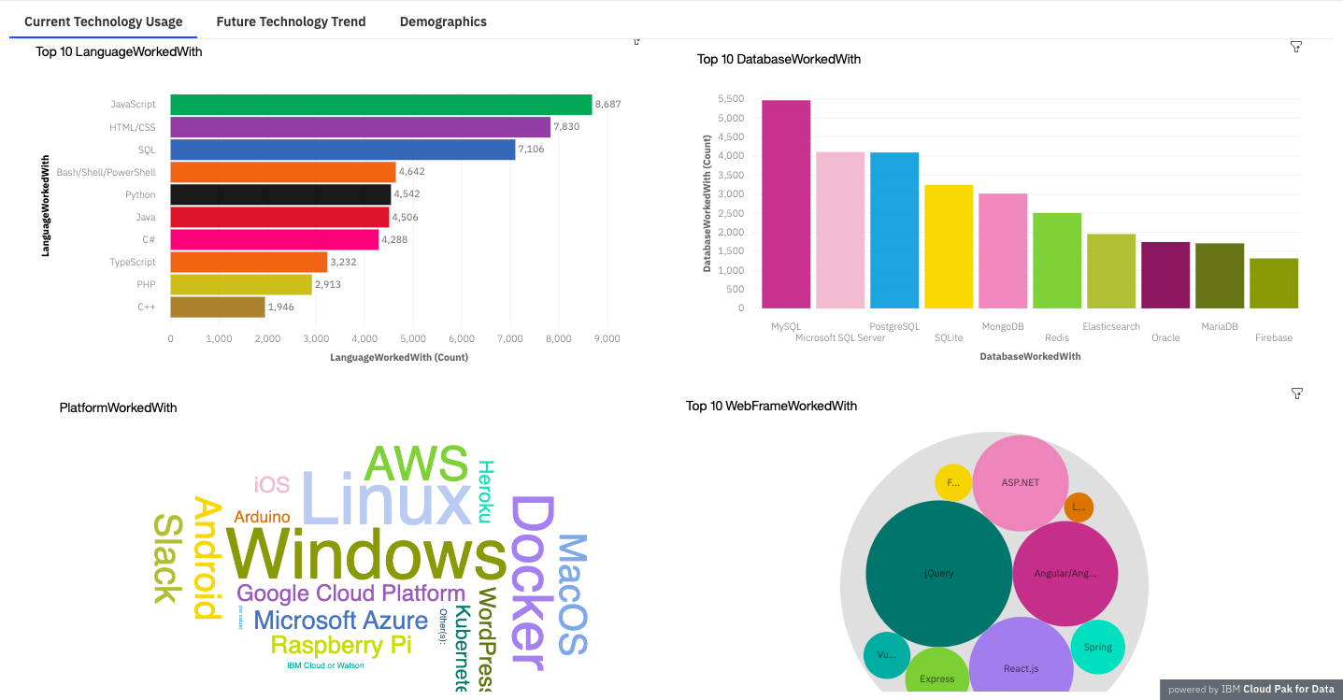
DASHBOARD TAB 1
Screenshot of dashboard tab 1 goes here

Slide 13
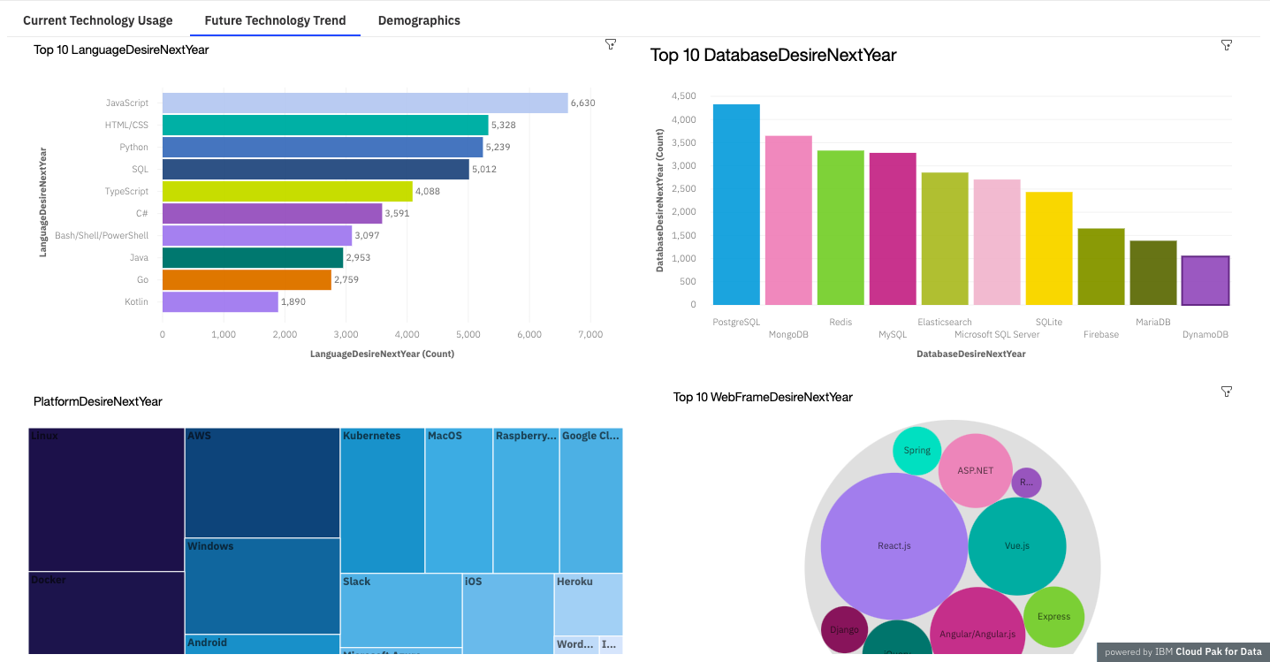
DASHBOARD TAB 2
Screenshot of dashboard tab 2 goes here

Slide 14
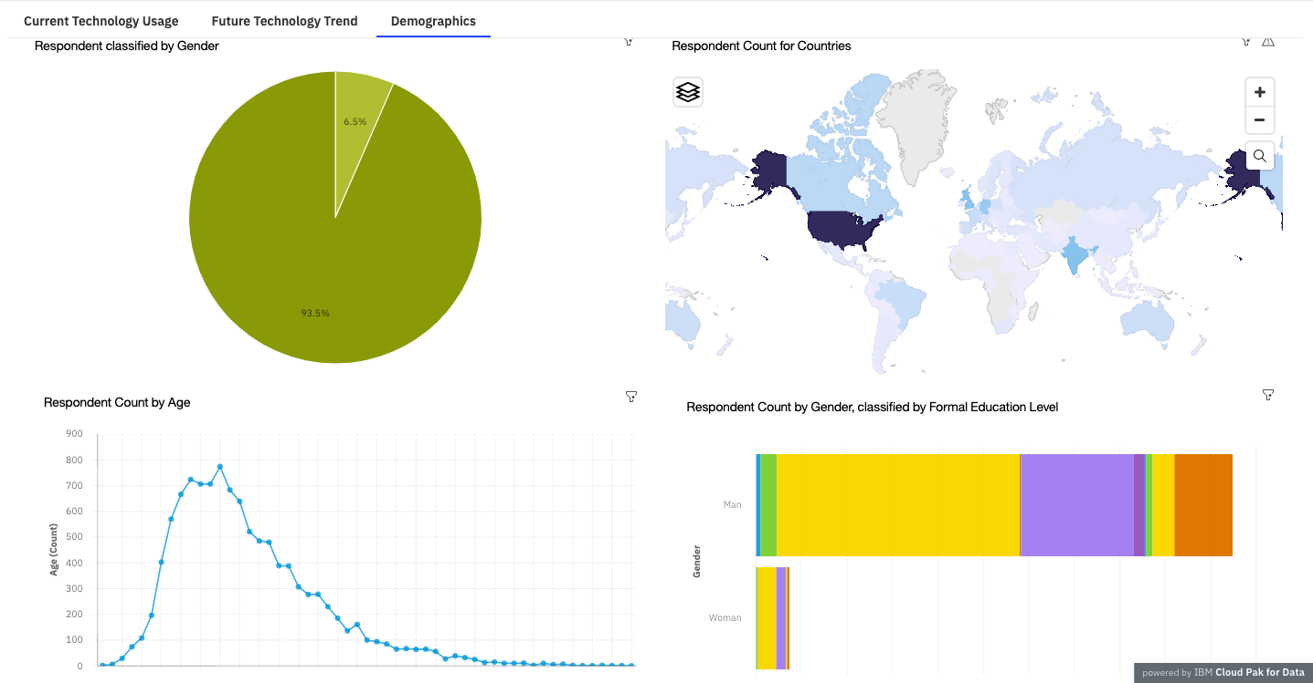
DASHBOARD TAB 3
Screenshot of dashboard tab 3 goes here

Slide 15
DISCUSSION
Current and future technology trends
Training and reskilling workers
Female presence in the technology field
Bridge divide in technology gaps in developing countries
Eliminate age and education discrimination in employment

Slide 16
OVERALL FINDINGS & IMPLICATIONS
Findings
Rapid changing technology every year
Concentration on several countries like USA and India
Gender gap in technology jobs
Platforms like Docker and AWS are growing
Implications
Companies need to be flexible and adjust to rapid changes
Need to spread technology out to lagging countries
Impact of job hiring’s
Shift to faster app deployments and cloud services in future

Slide 17

CONCLUSION
Technology trends for current and next year
Overview of programming languages, database and platform
Overview of demographics
Actions to be taken
In the future incorporate Machine Learning to predict trends and salaries

Slide 18
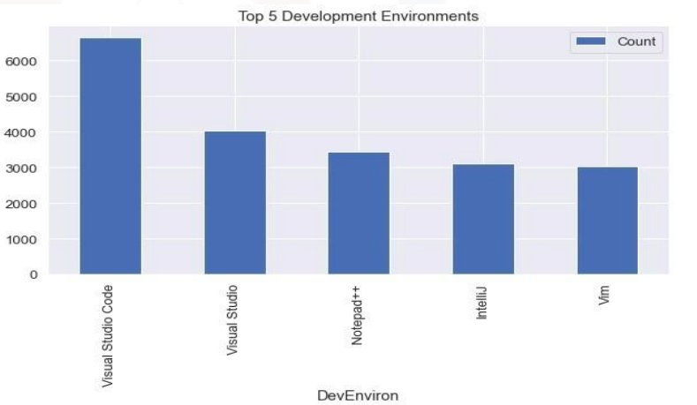

APPENDIX
Include any relevant additional charts, or tables that you may have created during the analysis phase.

Slide 19
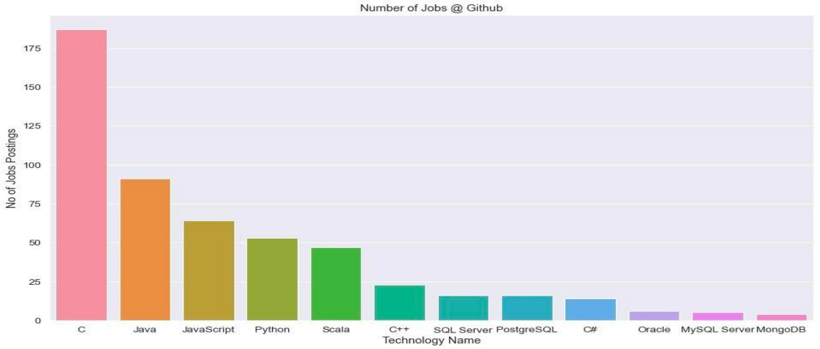
GITHUB JOB POSTINGS
In Module 1 you have collected the job postings data using GitHub API in a file named “github-job-postings.xlsx”. Present that data using a bar chart here. Order the bar chart in the descending order of number of job postings.

Slide 20
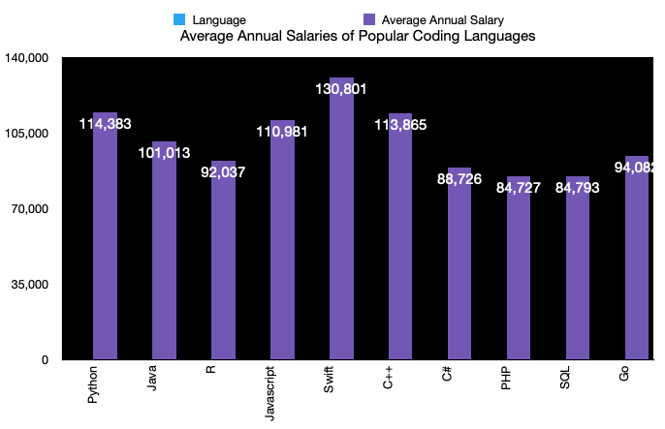
POPULAR LANGUAGES
In Module 1 you have collected the job postings data using web scraping in a file named “popular-languages.csv”. Present that data using a bar chart here. Order the bar chart in the descending order of salary.

